Slide 1

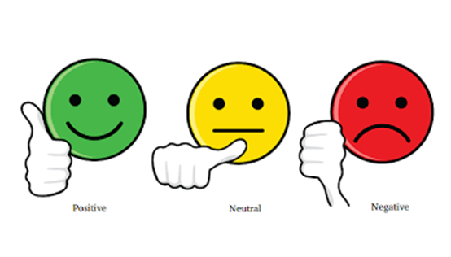

YouTube Comment Sentiment Analysis
Term Project – Group 5 | Introduction to Artificial Intelligence

Slide 2
Team Members
Pallavi Bongu
Sai Chaitanya Kolli
Keerthi Balabhadruni

Slide 3

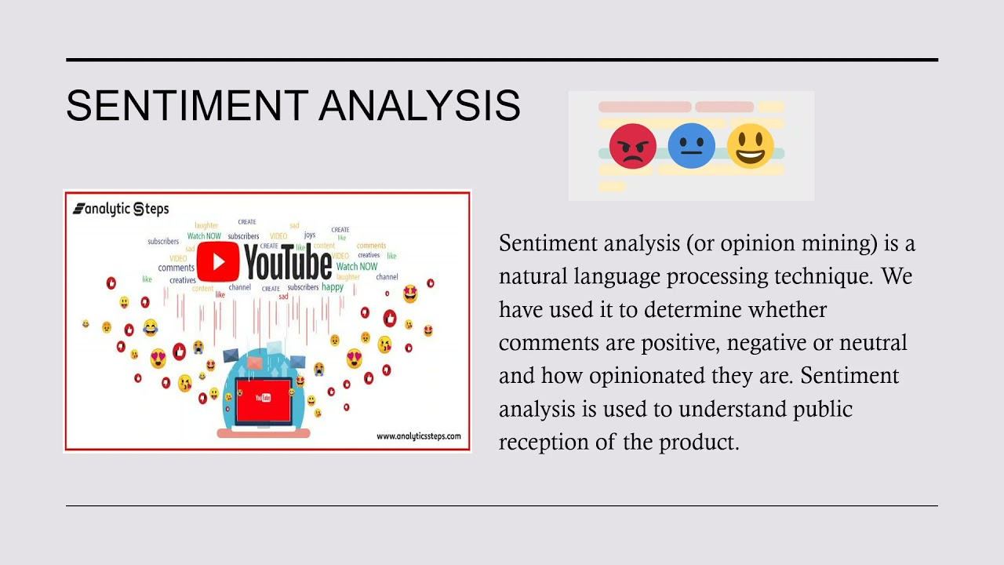
Sentiment Analysis- Brief Overview
Sentiment Analysis is the most common text classification tool that analyses an incoming message and tells whether the underlying sentiment is positive, negative or neutral.
I won the lottery Today Positive
The food is ready Neutral
The weather is terrible Negative
Examples

Slide 4

What’s Our Project Aims To Achieve
As a YouTube channel grows, it gets a lot of comments from viewers. These comments are important for understanding viewer expectations and improving engagement. However, not all comments are useful.
Some have mistakes and are not well-written. It's hard for content creators to find the most relevant comments. This project helps categorize comments based on sentiment and sentence types to help YouTubers find useful feedback for growing their audience.

Slide 5
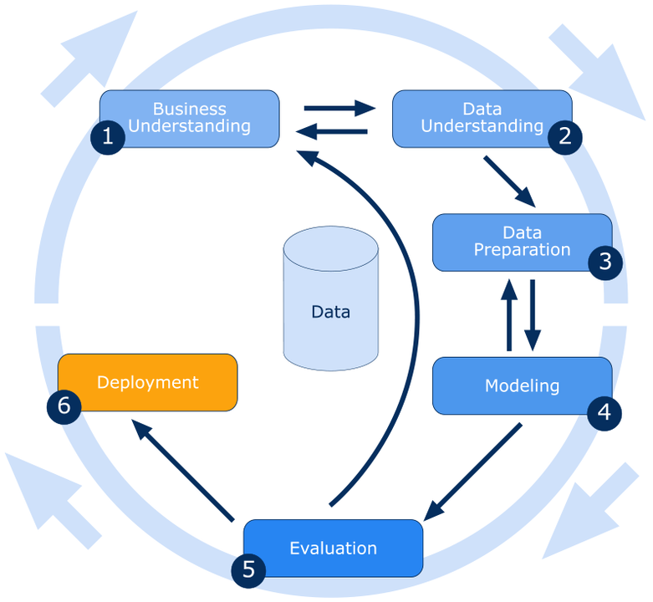
Crisp DM Methodology
CRISP-DM stands for Cross-Industry Standard Process for Data Mining, which provides a structured approach for planning and executing data mining projects.
It consists of six main phases:

Slide 6
Project Plan
Data Pre-Processing
Sentiment Classification
Prediction of Comments
Categorizing the Comments

Slide 7
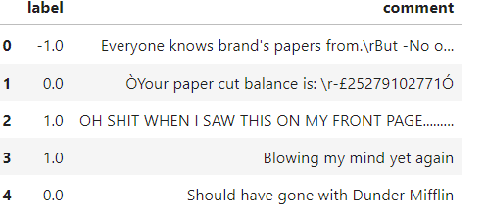
Data Collection
We have taken the datasets from Kaggle.
Link: https://www.kaggle.com/datasets/kevinleekrus/youtube-videos-comments-analysis

Slide 8
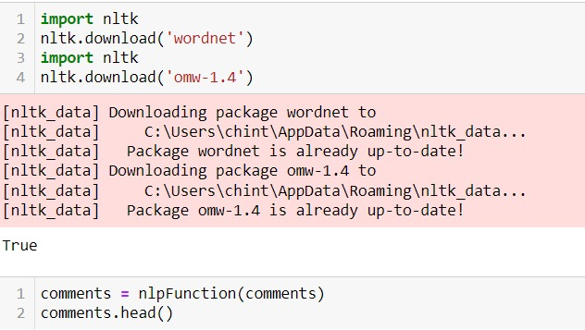
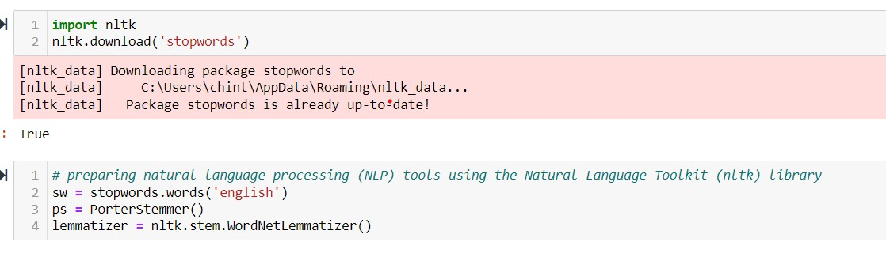
Data Pre-Processing
Data Labelling: The YouTube API extracts comments without polarity labels. TextBlob in Python calculates sentence polarity, identifying emotions in text based on words used.
Text Cleaning: Remove special characters, punctuation, and irrelevant information like URLs or usernames.
Tokenization: Split comments into individual words or tokens.
Normalization: Convert text to lowercase, handle contractions, and remove stopwords.
Lemmatization or Stemming: Reduce words to their root form to standardize text.

Slide 9
Sentiment Classification
Logistic Regression: It’s a predictive modeling algorithm for the classification where there is a labeled dataset with the categorical target variable, and it is used to predict sentiment.
Support Vector Classifier (SVC): SVC can learn complex patterns in the data and classify comments into positive or negative sentiments based on features extracted from the text.
Decision Tree: It can learn rules from the comment data, making decisions based on text features to predict sentiment.
Random Forest: It leverages the strength of multiple decision trees to classify sentiments in comments by aggregating their predictions.
Multinomial Naive Bayes (MNB): MNB works well with text data by considering the frequency of words or comments under a video.

Slide 10
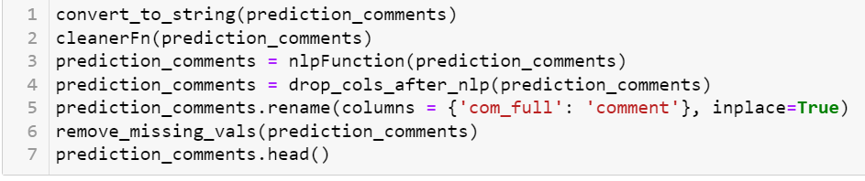
Prediction of Comments
Applied the trained model to predict sentiment labels for new, unseen comments by transforming and using the same preprocessing steps on these comments.

Slide 11
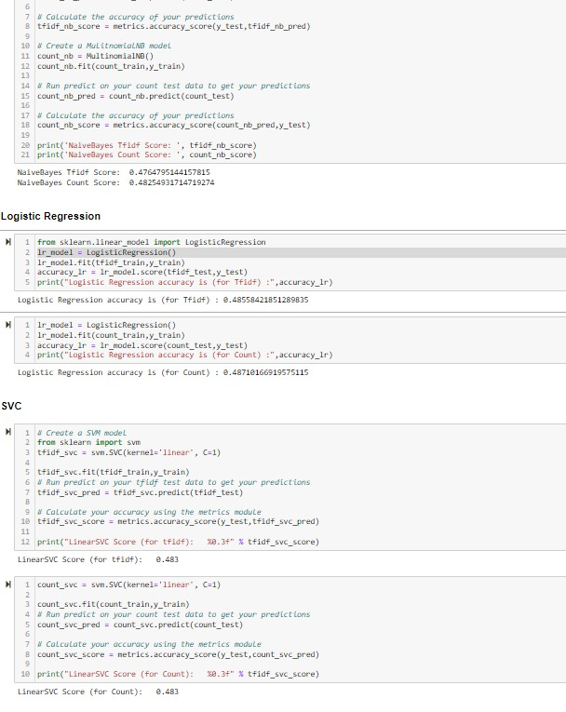
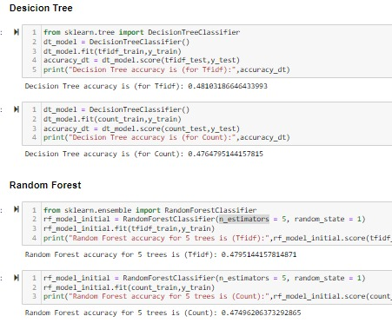
Evaluation
Evaluation metric: we have used is Accuracy, the model which has The higher the accuracy, the better the model is at correctly predicting the labels of the test set.
For the labels which I have used I got accuracy for each has as below:

Slide 12
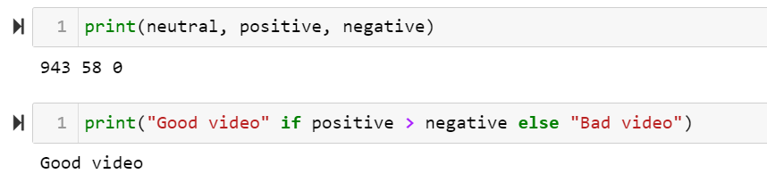
Results
We have extracted the positive, negative and neutral comments, to identify whether it is a good or bad video.

Slide 13


